Slide 1
Programming Fundamentals
Lecture 16

Slide 2
Objectives
Array of objects and initialization
Constructor and Destructor calling in Array of Objects

Slide 3
Array of Objects
Previously we have seen that an array of objects can be created as
    Class_name array_name[size];
    Vehicle cars[10];
Normally the array objects are initialized with the default constructor
It can be verified by the constructor calls

Slide 4
Initializing the Array Objects with Overloaded Constructor (1/2)
If we want to initialize the array objects with overloaded constructor, then we need to do it for all the array elements
Previously we have seen the syntax like
Vehicle car[3] = {(2000,3,2),(4000,6,4),(500),3,1};
The above syntax will only work if we have set default values in overloaded constructor
The object initialization is invalid as can be seen from example code “Array_of_objects”

Slide 5
Initializing the Array Objects with Overloaded Constructor (2/2)
The correct way to initialize the array of objects is given below
Vehicle car[3]={Vehicle(2000,3,2), Vehicle(4000,6,4), Vehicle(500),3,1};
Here the expression Vehicle(2000,3,2) is calling the overloaded constructor and as a result a temporary object will be created
If we want to initialize the 1st and last object of above array with overloaded constructor and the 2nd object with default constructor then the syntax is
Vehicle car[3] = {Vehicle(2000,3,2), Vehicle(), Vehicle(500),3,1};

Slide 6
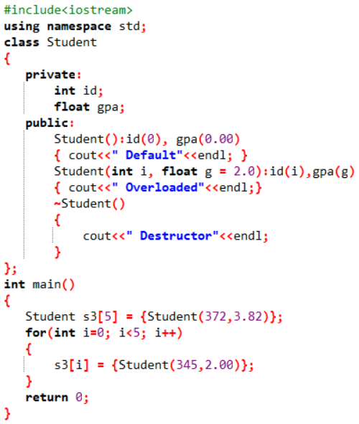
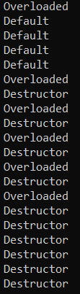
Practice Problem 1
Write the output of the following program
Reasons/Explanation
Upon the creation of array, only 1st object is initialized with overloaded constructor and remaining 4 are initialized with default constructor
In the for-loop objects are defined. For each iteration, a temporary object is created, and the value is assigned to array object
Before the next iteration, the temporary object is destroyed
At the end of the program, all the objects are destroyed so the destructor is called 5 times

